Slide 1
FDP
From Pipelines to Production
Dr. Shreyas Rao
Professor, Dept. of CSIS, BITS-Pilani

Slide 2
Day 3
The Generative System: RAG, LLMOps and AgentOps

Slide 3
Objectives
Build a Generative AI Application using RAG
Implement LLMOps for the RAG application and analyze the metrics
Implement AgentOps for AI Agents

Slide 4
Basics
AI Paradigms: Predictive, Generative, and Agentic AI
J. Schneider, "Generative to agentic AI: Survey, conceptualization, and challenges," arXiv preprint, arXiv:2504.18875, 2025. doi: 10.48550/arXiv.2504.18875

Slide 5
Differences
Predictive AI: Uses past data to predict future outcomes.
Generative AI: Creates new content based on learned patterns.
Agentic AI: Acts autonomously to achieve goals using reasoning and tools.

Slide 6
Generative AI
Definition
A system based on a foundation model that generates digital artifacts based on natural user instructions.
Digital artifacts can range from simple binary outputs to complex forms like text, images, and videos.
Natural user instructions are easy for humans to understand and do not require technical knowledge, such as everyday language or visual inputs like photos or sketches.

Slide 7
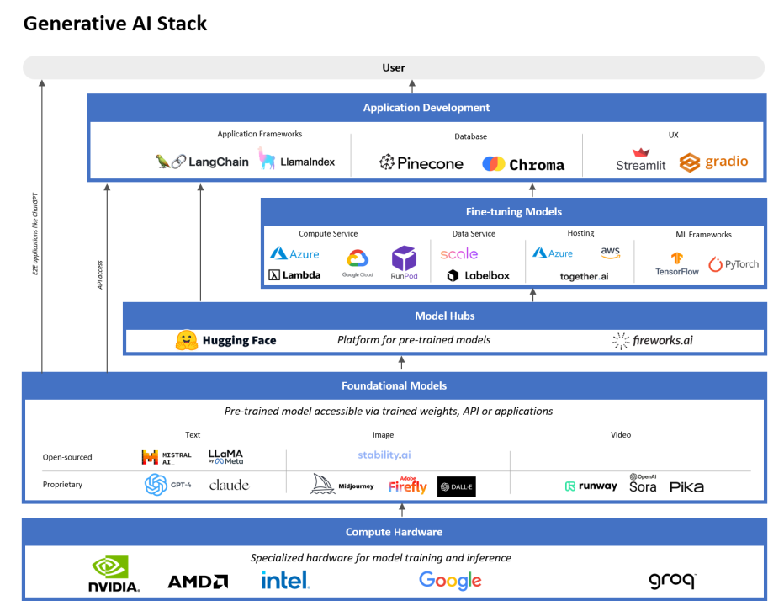
Generative AI Architecture

Slide 8
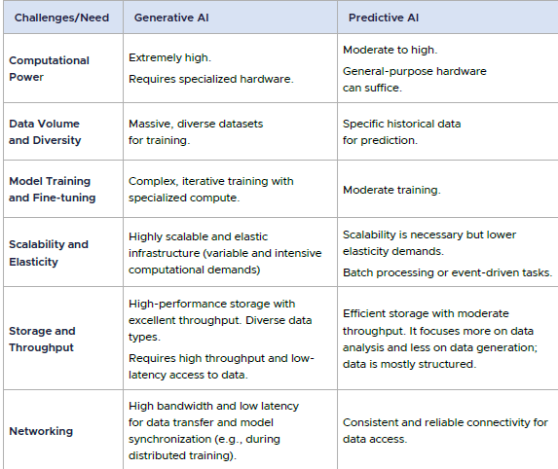
Generative vs Predictive AI

Slide 9
Agentic AI
Definition 1 [Nvidia]
"Agentic AI uses sophisticated reasoning and iterative planning to autonomously solve complex, multi-step problems.“
Definition 2 [OpenAI]
"Agentic AI systems are AI systems that can pursue complex goals with limited direct supervision"
Definition 3
“A system based on a foundation model that performs tasks potentially yielding artifacts based on natural user instructions, where the system is able to conduct and express complex reasoning including planning and reflection to solve tasks that require interaction with an environment or elaborate tool use”

Slide 10
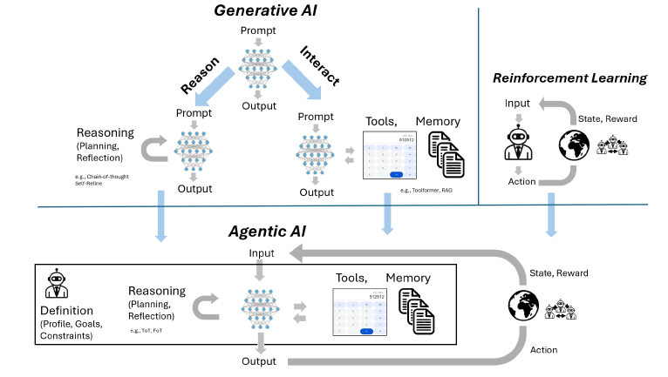
Generative vs Agentic AI
Generative AI: "Tell me what to do, I’ll generate an answer"
Agentic AI: "Give me a goal, I’ll figure out the steps, act, and improve until it’s done"
Generative AI + Reasoning + Tools + Feedback Loops → Agentic AI

Slide 11
Accessing LLMs through APIs

Slide 12
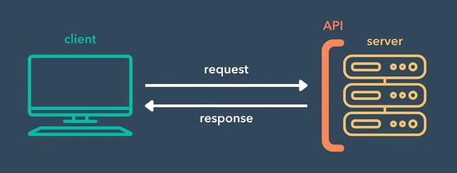
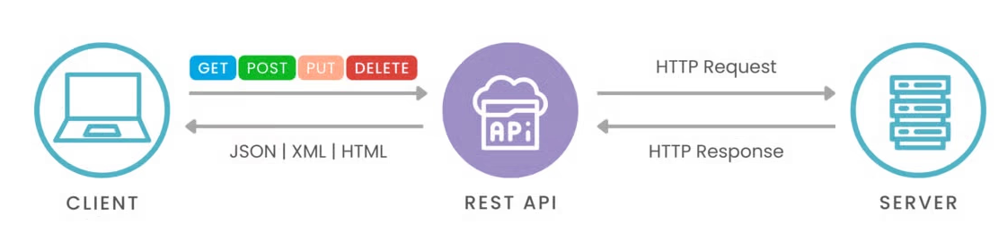
API
APIs are a standard way for applications to communicate over the web
Use HTTP Protocol

Slide 13
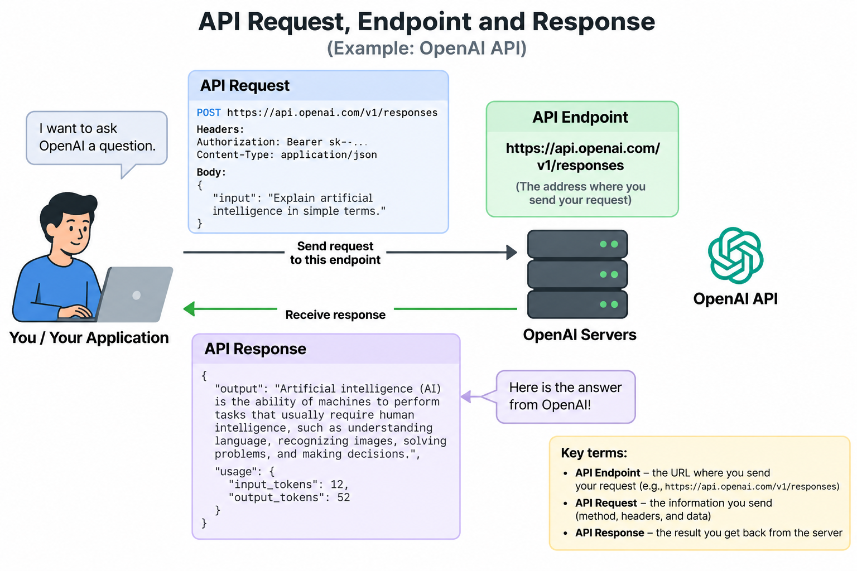
API - Request, Endpoint, & Response

Slide 14
Some Examples
Hugging Face -> https://router.huggingface.co/v1/chat/completions
AWS Bedrock -> https://bedrock.us-east-1.amazonaws.com/models [Returns list of models]
AWS Bedrock -> https://bedrock.us-east-1.amazonaws.com/models/{model-id}/invoke [Inference]
Google Gemini -> https://generativelanguage.googleapis.com/v1beta/{model}
OpenAI -> https://api.openai.com/v1/responses
Cohere -> https://api.cohere.ai/v2/chat
Mistral -> https://api.mistral.ai/v1/chat/completions
All are REST / OpenAI-compatible APIs, with “POST” as the HTTP method

Slide 15
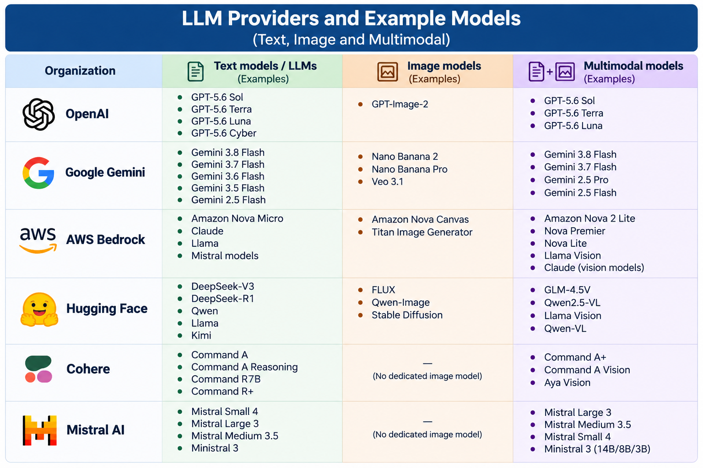
Approach to Access LLMs: Through APIs

Slide 16
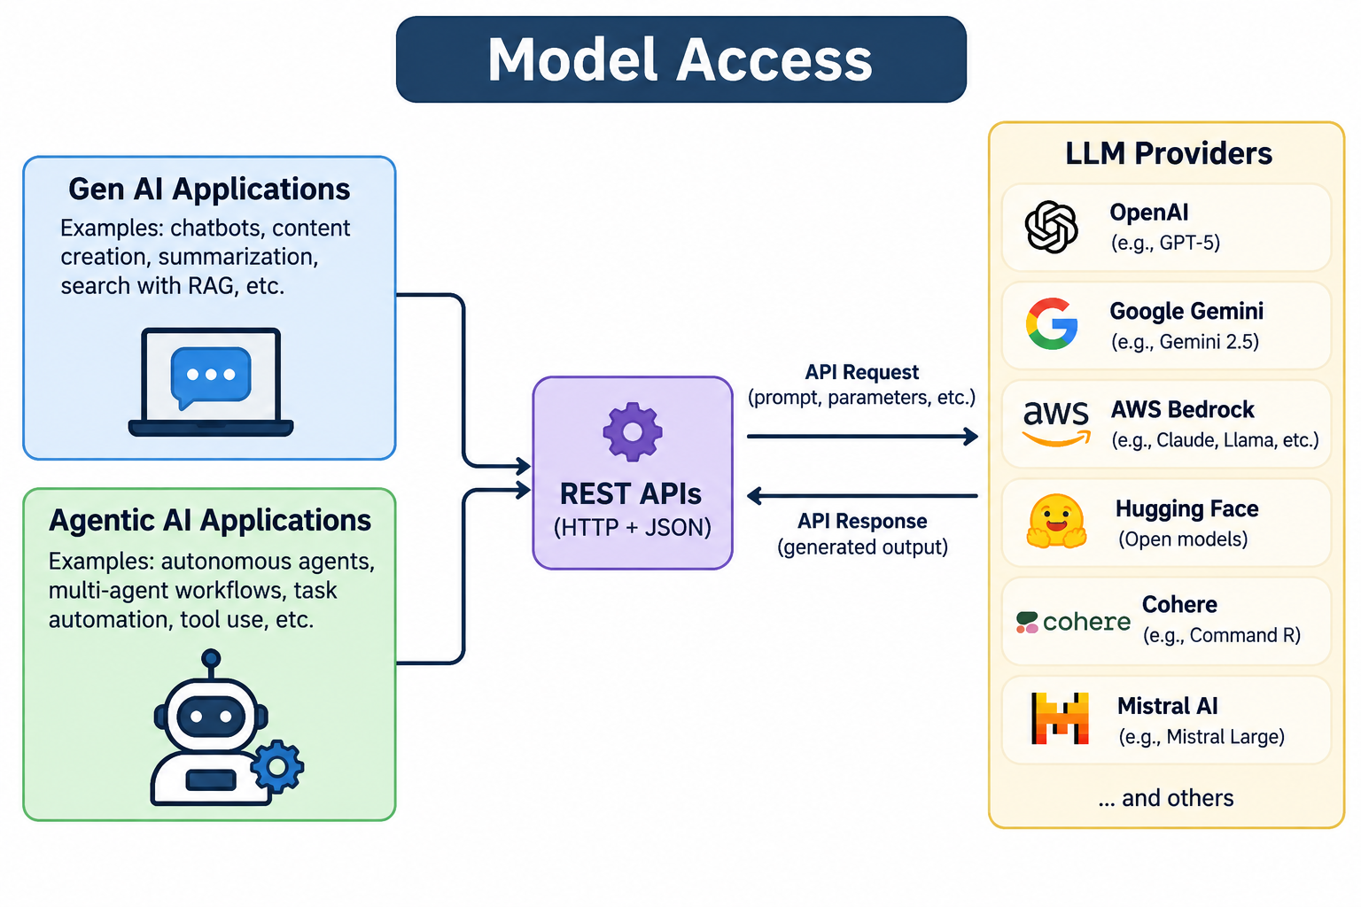
Text, Image & Multi-modal Models
LLMs can be accessed by applications through APIs exposed by model providers such as OpenAI, Google Gemini, AWS Bedrock, Hugging Face, Cohere, and Mistral AI

Slide 17
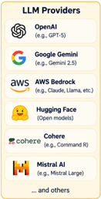
Approaches to access LLMs/ SLMs
Local
Hosted Open-Source API
Managed API / Managed Cloud AI Services
Institutional
Cloud GPU
Where do these models execute?

Slide 18
Managed API / Managed Cloud AI Services
Access commercially hosted LLMs through APIs. The provider manages the model, GPUs, scaling, and inference infrastructure.
Options
OpenAI API
Google Gemini API
Anthropic API
Azure OpenAI
Amazon Bedrock
Google Vertex AI

Slide 19
RAG Architecture
Retrieval-Augmented Generation (RAG) is an AI architecture that enhances Large Language Models (LLMs) by grounding their responses in external, proprietary, or up-to-date data.
By fetching relevant information first and injecting it into the prompt, RAG minimizes hallucinations without requiring expensive model retraining

Slide 20
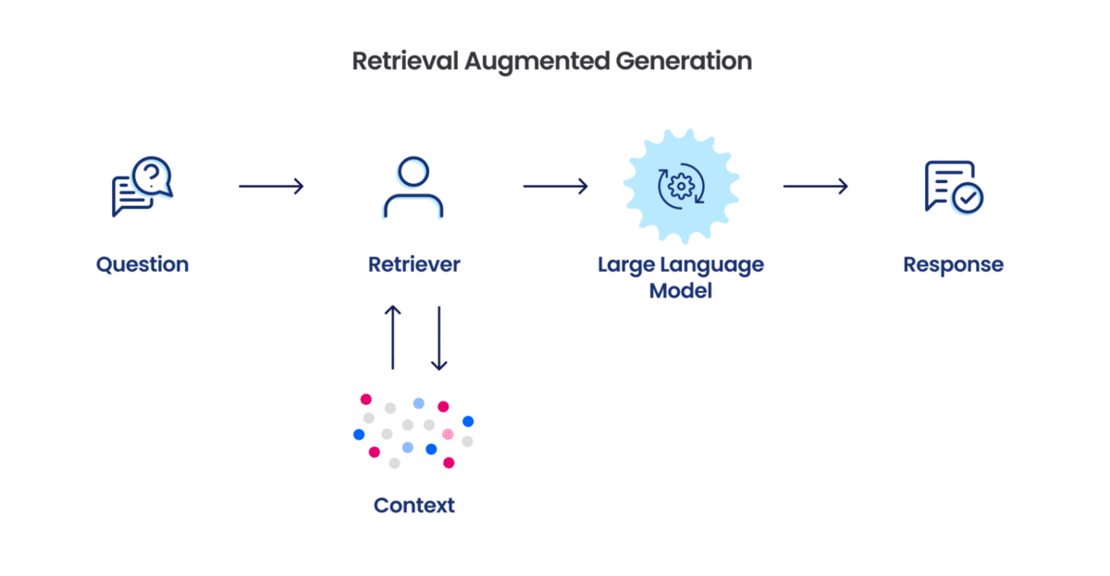
RAG Architecture [Simplistic]

Slide 21
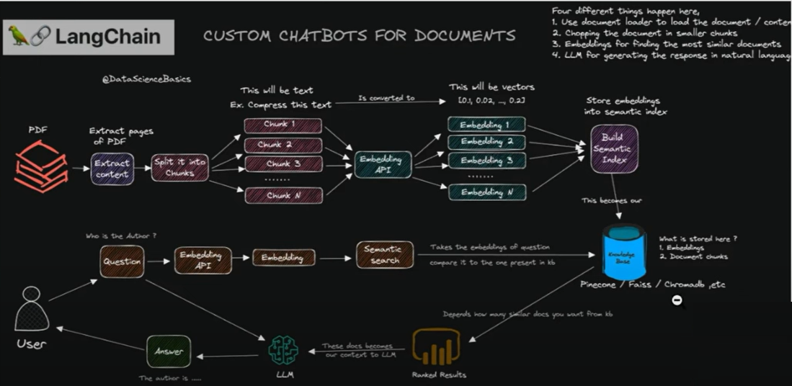
RAG Architecture [Detailed]

Slide 22
LangChain
LangChain is an open-source framework designed to streamline the development of applications that integrate with language models, particularly large language models (LLMs) like OpenAI's GPT models.
It is widely used to build advanced applications such as chatbots, virtual assistants, document summarizers, and any other software that requires natural language processing (NLP) capabilities.

Slide 23
Embedding Types
OpenAI Embeddings: Embeddings generated by OpenAI's models, suitable for a wide range of NLP tasks.
Ex: text-embedding-3-large, text-embedding-3-small
BERT Embeddings: Derived from the BERT model, capturing semantic meaning and context in text.
Sentence Transformers (e.g., Sentence-BERT): Specially optimized for sentence and document embeddings, capturing semantic relationships effectively.
FAIR’s Dense Passage Retriever (DPR): Optimized for retrieval tasks, commonly used in open-domain question answering.
GloVe (Global Vectors for Word Representation): Pre-trained embeddings that capture semantic relationships between words, though they lack contextual awareness.

Slide 24
Vector Stores
Pinecone: A managed vector database offering scalable and fast similarity search for high-dimensional embeddings.
FAISS (Facebook AI Similarity Search): An open-source library by Facebook optimized for fast, large-scale similarity search.
Chroma (ChromaDB) is an open-source vector database designed to store, manage, and retrieve embeddings for AI applications like semantic search and RAG systems.
It combines efficient vector indexing with lightweight metadata storage (using SQLite) for fast, local-first development.
ElasticSearch with KNN Plugin: A search engine with a plugin for k-nearest neighbors (KNN) search, enabling vector-based similarity search within text-based indices.

Slide 25
Chroma DB
Collection
├── IDs
├── Documents (text)
├── Metadata
└── Embeddings (vectors)
↓
SQLite (storage)
+
HNSW index (fast retrieval)
ID: chunk_1
Document: "Text from page 1..."
Embedding: [0.23, -0.11, ...]
Metadata: {
"source": "file.pdf",
"page": 1,
"chunk": 1
}
ChromaDB stores text in SQLite tables and embeddings as vectors linked to those records.
Each chunk = one document in ChromaDB
It uses an HNSW index for fast similarity search over embeddings.
HNSW (Hierarchical Navigable Small World) index is a data structure used for fast similarity search

Slide 26
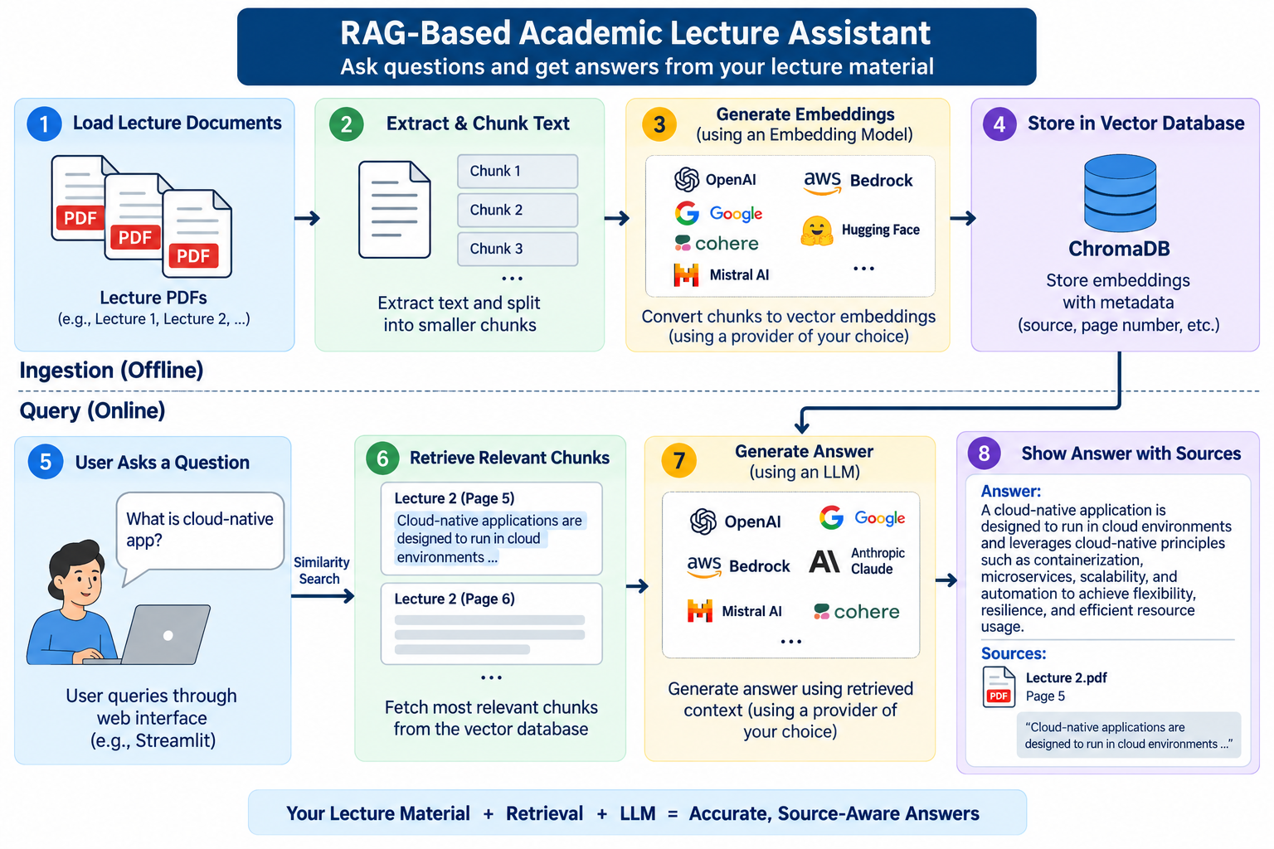
Use Case
RAG-Based Academic Lecture Assistant
We require Open AI APIs for Stage 3 – “Generate Embeddings” and Stage 7 – “Generate Answer”

Slide 27
Demo & Hands-On

Slide 28


Slide 29
APPENDIX

Slide 30
Approaches to access LLMs/ SLMs
Local
Hosted Open-Source API
Managed API / Managed Cloud AI Services
Institutional
Cloud GPU
Where do these models execute?

Slide 31
Local
Run the LLM/SLM directly on a local laptop, desktop, or workstation.
Creates a “Local GPT” for users.
Options
Ollama
LM Studio
llama.cpp
GPT4All

Slide 32
Local - Ollama
Laptop / PC
↓
Install Ollama
↓
ollama pull gemma2:2b / ollama pull nomic-embed-text [Pulls from Ollama Model registry]
↓
ollama run gemma2:2b [Test: Give me Binary search code in Python; Ctrl+d to exit]
↓
Python / RAG / Agent framework [ollama list]
↓
Local Gemma 2B

Slide 33
Hosted Open-Source API
Access open-source/open-weight LLMs through an API, without managing the underlying GPU infrastructure yourself
Options
Hugging Face Inference
Together AI
Fireworks AI
Groq
Cerebras

Slide 34
Hugging Face Inference
Options for LLM
Qwen/Qwen2.5-7B-Instruct
HuggingFaceH4/zephyr-7b-beta
microsoft/Phi-3-mini-4k-instruct
Options for SLM
HuggingFaceTB/SmolLM2-1.7B-Instruct
google/gemma-2-2b-it
Options for Embedding
sentence-transformers/all-MiniLM-L6-v2
BAAI/bge-small-en-v1.5
sentence-transformers/all-mpnet-base-v2
"mixedbread-ai/mxbai-embed-large-v1

Slide 35
Managed API / Managed Cloud AI Services
Access commercially hosted LLMs through APIs. The provider manages the model, GPUs, scaling, and inference infrastructure.
Options
OpenAI API
Google Gemini API
Anthropic API
Azure OpenAI
Amazon Bedrock
Google Vertex AI

Slide 36
Cloud GPU
Rent GPU infrastructure from a cloud provider and deploy/manage the model yourself.
Options
RunPod – Pods / Serverless approaches *
AWS EC2 GPU instances
Azure GPU VMs
Google Cloud GPU VMs
Other GPU cloud providers
* RunPod Pod - dedicated GPU environment; you manage the deployment
RunPod Serverless - on-demand GPU inference; infrastructure scaling is handled by the platform

